Slide 1

CADET CHALLENGE 2024
ACCT UK
#CadetChallenge2024

Slide 2




WHO ARE ACCT UK?
ACCT UK stands for The Army Cadet Charitable Trust UK, we are the official charity of the
Army Cadet Force (ACF).
For over 90 years ACCT UK have
supported the Army Cadets across
the board to improve and enhance the ACF experience.

Slide 3
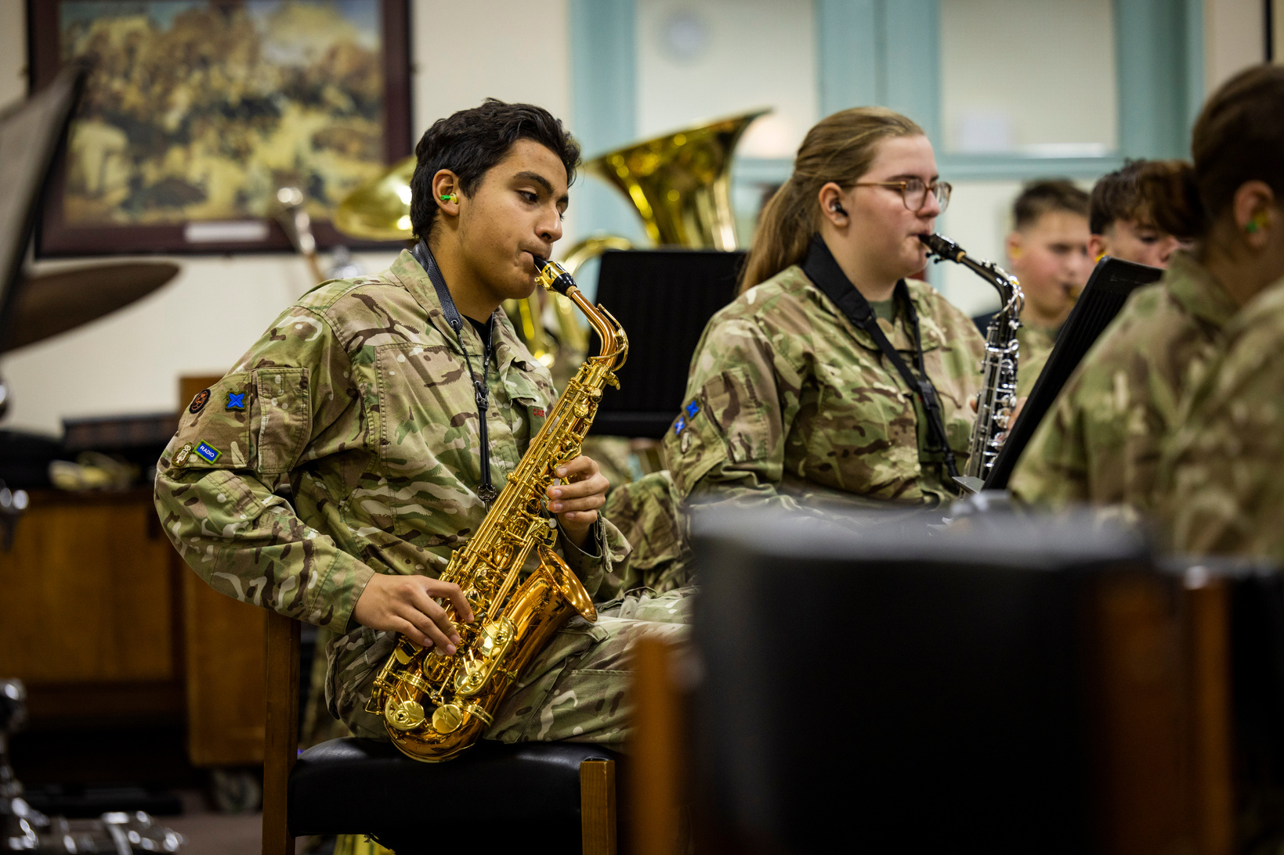
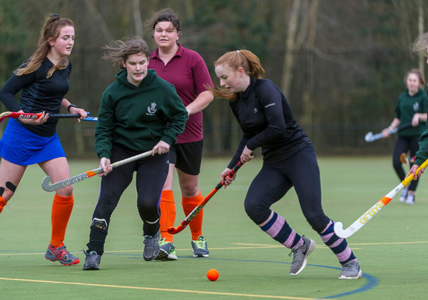
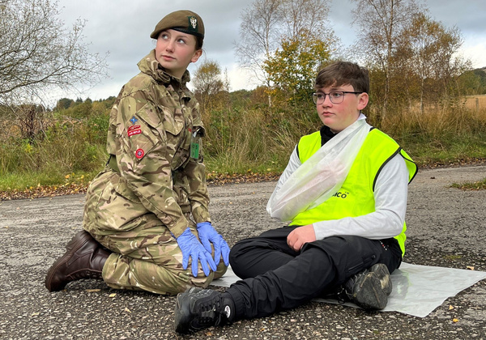
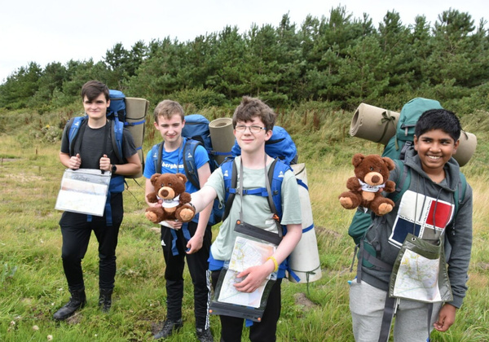
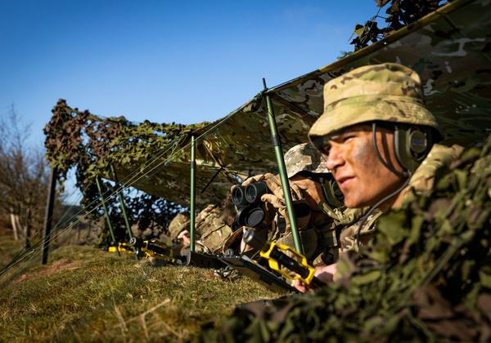
WHAT WE DO?
ACCT UK offer financial grants to ensure camps, trips, additional equipment and specialised training remain affordable for all Cadets
The Duke of Edinburgh’s Awards
Adventure Training
To continue the development of DofE, to fund for additional equipment and programme costs.
To continue the development of DofE, to fund for additional equipment and programme costs.
Music
Sports
First Aid
To participate in music, purchase instruments, get lessons & attend music camps.
To participate in sports, purchase equipment, attend camp or take part in competitions.
All First Aid training for cadets and adult volunteers is supported by funding from ACCT UK.

Slide 4

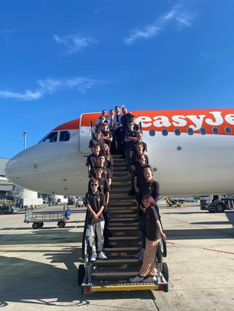
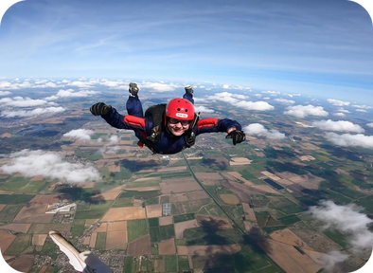
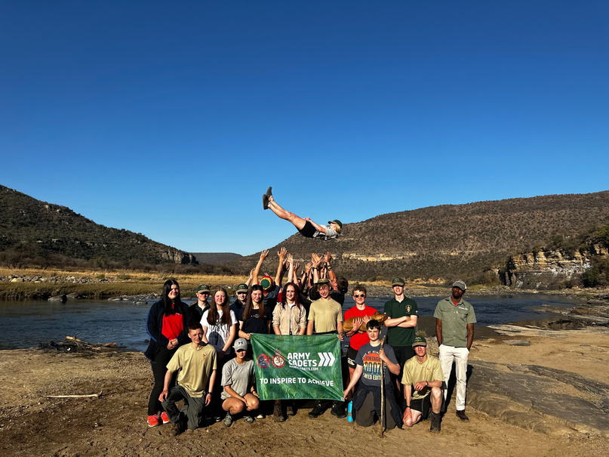
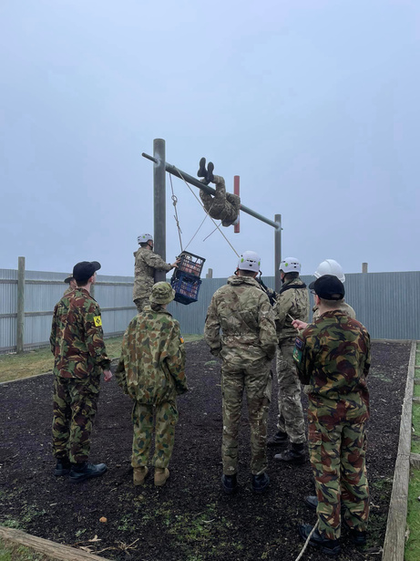
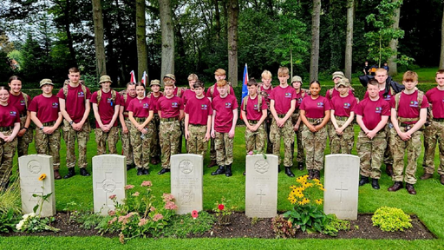
Our 2023 Grants Impact
We supported 4,870 cadets and adult volunteers. We awarded grants worth £109,670.59.
Individual Grants: Empowering over 900 cadets to engage in activities like sports; from skiing and climbing to battlefield tours and overseas expeditions like South Africa and Cyprus.
County Grants: Enabling counties to purchase kit and equipment in support of activities such as music, shooting paddleboarding and mountain biking! Extending these amazing activities to nearly 4,000 cadets.
Additionally, with our partnerships, we were able to award:
🌟CVC Partnership: Supporting 430 cadets from across the devolved nations through their BTEC Level 2 in Teamwork and Personal Development Qualification, managed directly by Cadet Vocational College.

Slide 5

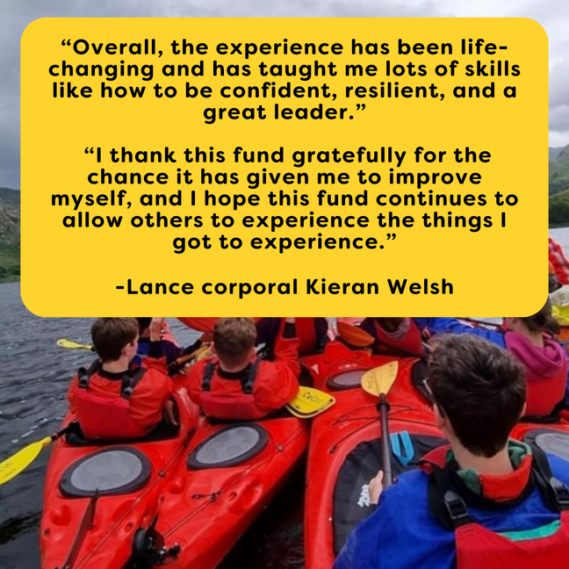
MATTHEW BACON BURSARY
ACCT UK’s Matthew Bacon Bursary supports young people who need support to make a change in life to achieve their full potential through the ACF.
The bursary transforms the lives of teenaged Army Cadets who have all reached new milestones through participating in the Outward Bound Trust (OBT) 14 day adventure challenge.
Notes:
11

Slide 6

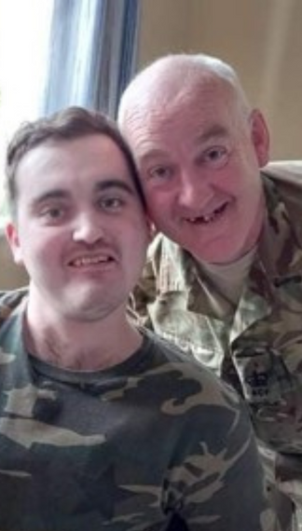
We also support:
Adult volunteers
(CFAVs)
PERSONAL ACCIDENT
AND TRAVEL INSURANCES
To have access to financial assistance to develop their youth leadership skills. We also provide Insurance and well-being support..
ACCT UK manages the travel and activity insurance premiums for all cadets and adult volunteers in the Army Cadet Force.
Jack Land was an adult volunteer with Wiltshire ACF. When travelling home from a course he was severely injured in a car crash. Jack’s father Ian “was so grateful for the ACCT UK Insurance.

Slide 7

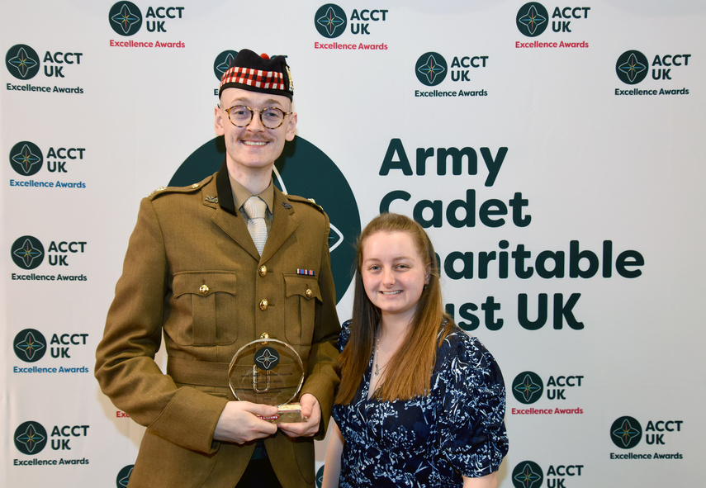
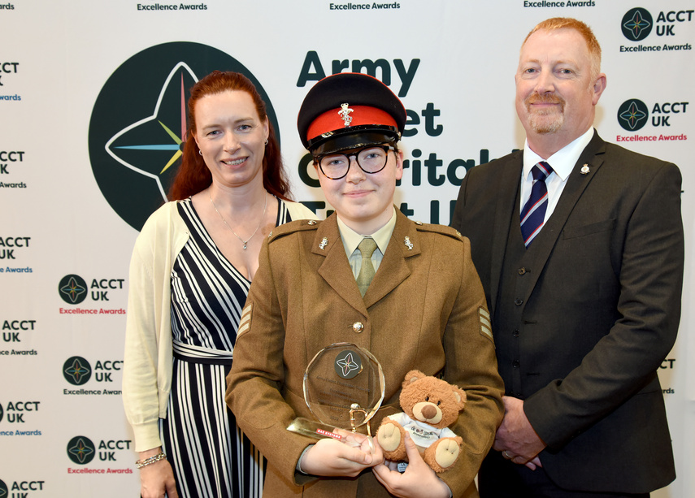
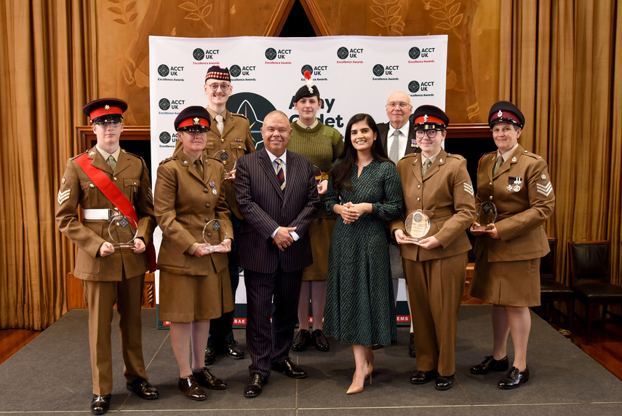

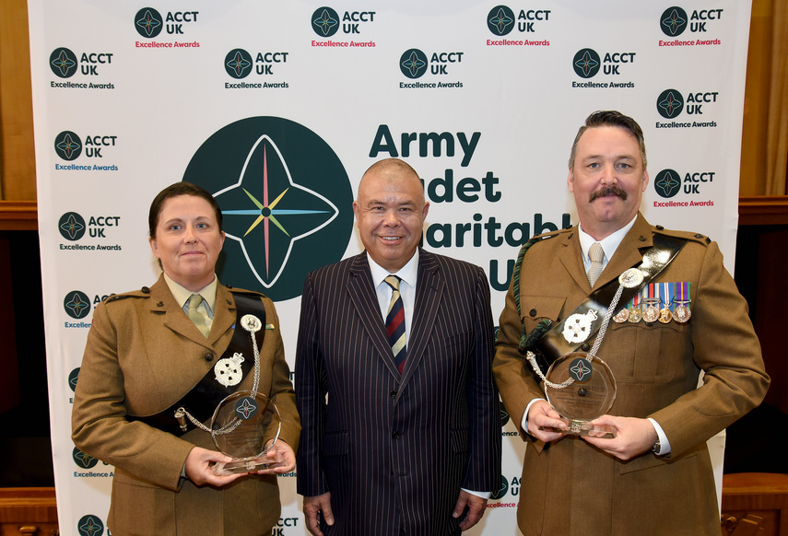
ACCT UK EXCELLENCE AWARDS
We host an annual awards event The ACCT UK Excellence Awards to recognise outstanding cadets and CFAVs, as well as seek recognition for our cadets and adult volunteers in external awards and non-state honours e.g. Royal Humane Society.
Cadet Challenge 2024

Slide 8
WHY SUPPORT ACCT UK?
ACCT UK is your charity - we are here for ALL cadets and CFAVs in the Army Cadet Force. No-one will ever understand the importance of the ACF better than you….
You may not need funding for your next adventure, but many cadets will. Help us ensure ACCT UK will be able to help as many of the ACF family as possible.
Cadet Challenge 2024

Slide 9
CADET CHALLENGE 2024
We’re asking
each cadet and adult volunteer
to raise a minimum of £10
for ACCT UK in 2024.
There will be a Fundraising Award given for both the cadet and the CFAV who are our ‘star fundraisers’ which will include travel and accommodation to London for the Excellence awards ceremony for them and a guest.
You will also be entered into the competition for the best fundraising group with an award and a £200 voucher.
For more information go to: armycadets.enthuse.com/cf/cadetchallenge2024
Cadet Challenge 2024

Slide 10
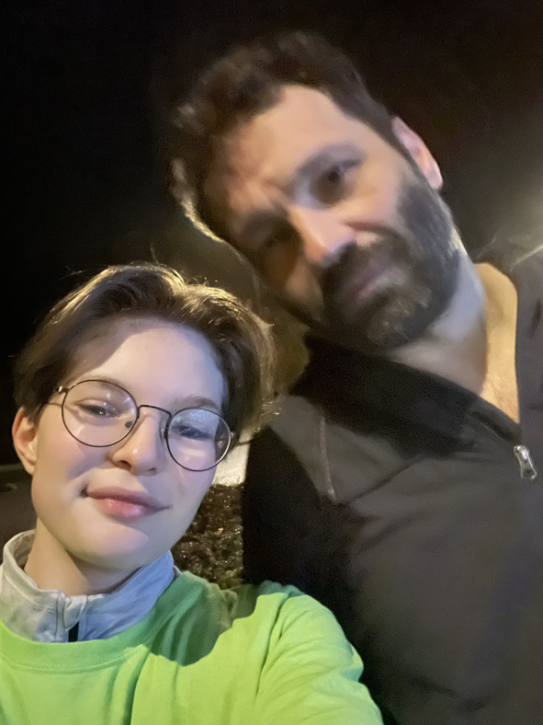
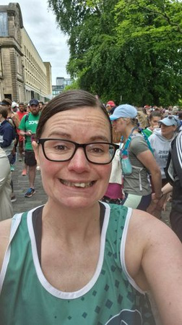
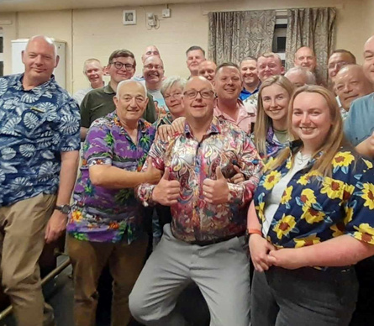
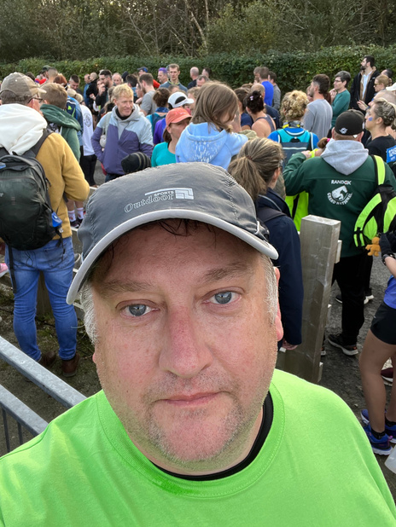
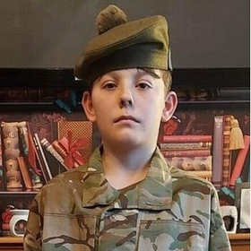
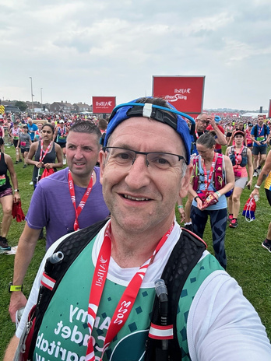
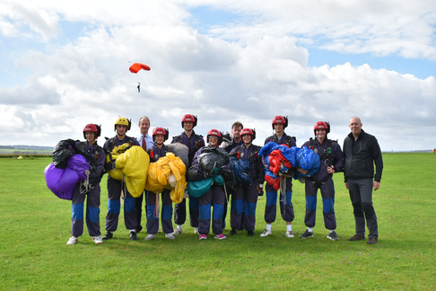

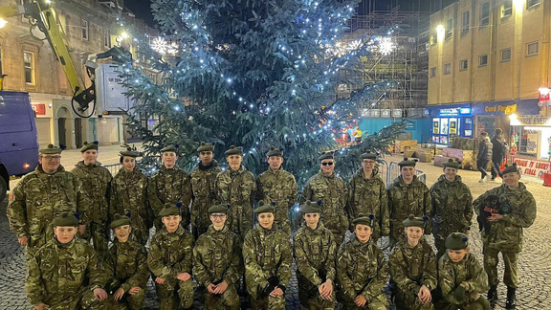
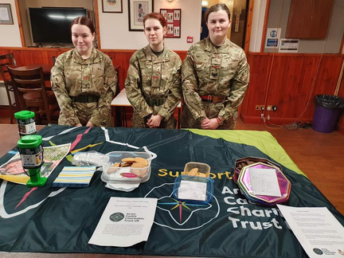
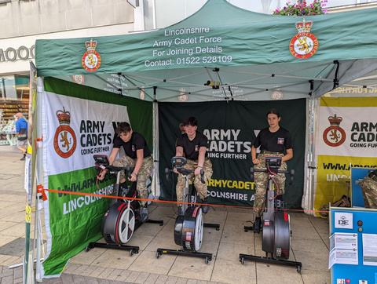

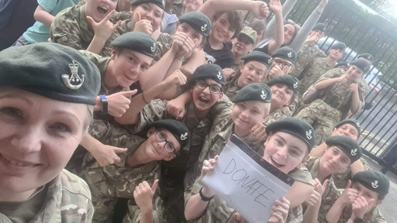
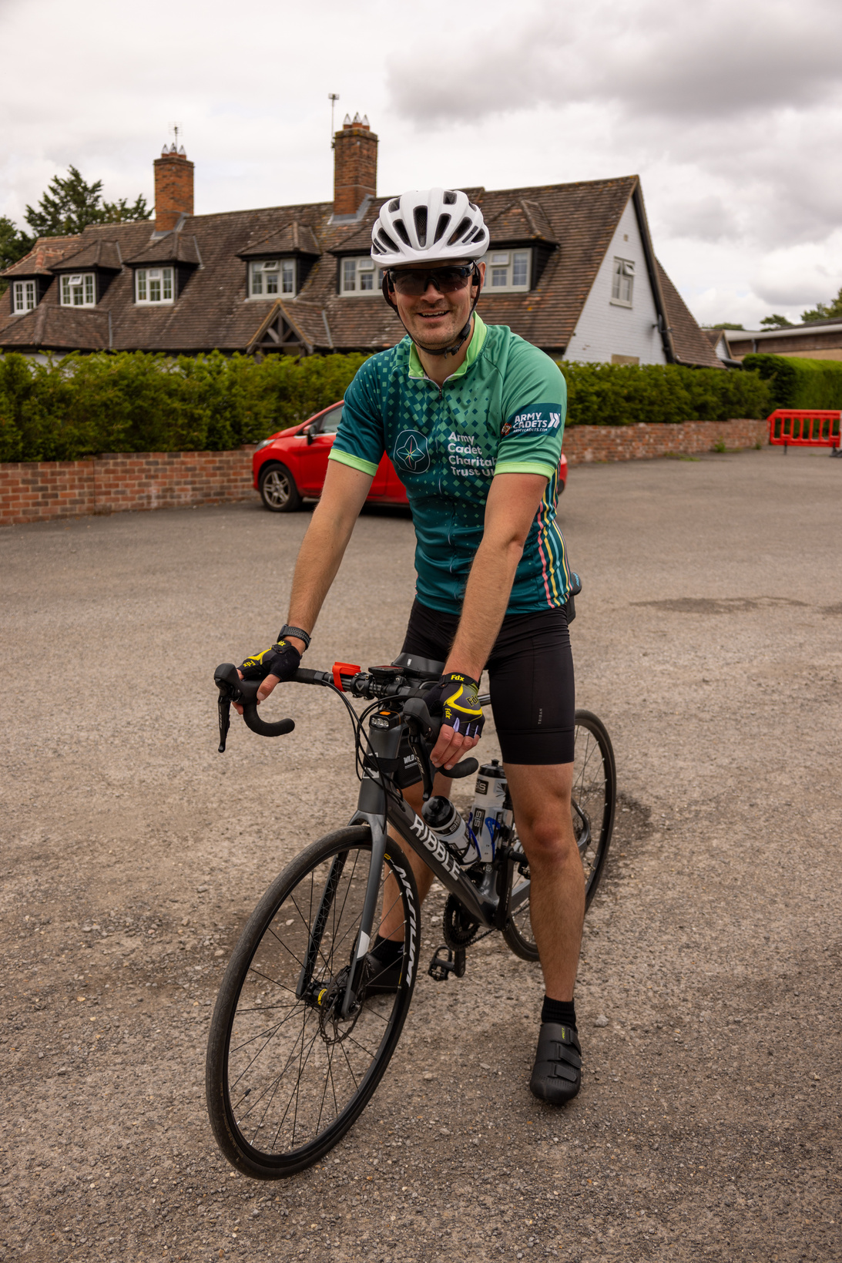
Thank you to everyone for taking part in CADET CHALLENGE 2023.
Congratulations to our winners.

Slide 11
You all do so much for charities and in your local communities, if you could find the time to support us too and take part in the
Cadet Challenge 2024,
it would make a world of difference.
Thank you,
Help us, help you.
Cadet Challenge 2024

